Slide 1
Linux Administration
Week 3
App installs/updates, repos, file management

Slide 2

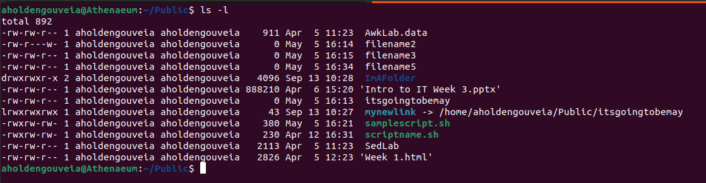
Permission review
Directory access
X for directories will allow us to control who can go inside the directory, R would be to read contents of directory
Such as hiding directories on websites
File permission
Owner, Group, World
RWX
chmod using octal (0-7) or +rwx
Hidden files (.hiddenFile)
Difference between – d and l at beginning of line

Slide 3

File Access Commands
Chmod – change file permissions
Chown – change file owner
Chgrp - Regular users can change group membership of a file

Slide 4
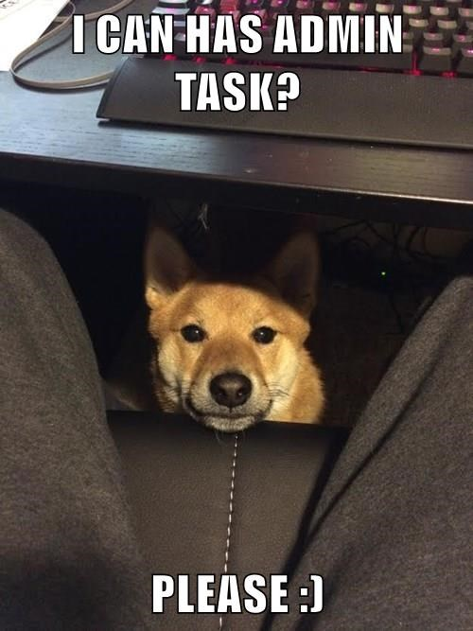
Activity
Make a bunch of files and folders
Try each of the chmod, chgrp, chown commands
Create a group, add a user to the system then add the user to your group. Make sure to check the user can login.

Slide 5
System files
/ The directory called “root.” It is the starting point for the file system hierarchy.
Note that this is not related to the root, or superuser, account. root tree does not imply physical location parts of the tree can be on different partitions and even separate devices (within the network sort of like onedrive)
/bin Binaries and other executable programs.
/etc System configuration files.
/home Home directories.
/opt Optional or third party software.
/tmp Temporary space, typically cleared on reboot.
/usr User related programs.
/usr/bin and /usr/sbin (for admins)
/var Variable data, web sites (webroot) and log files.

Slide 6
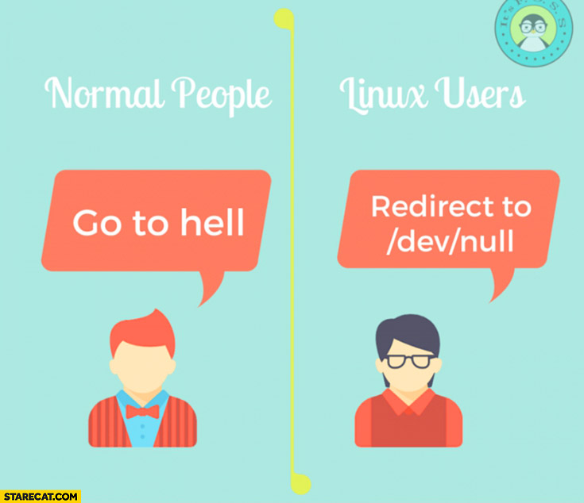
Special files
/dev/null
Immediately discards info and returns end of file (EOF)
Also known as bit-bucket or blackhole
> /dev/null 2>&1
Dumps everything to /dev/null not just stout
/proc
Illusionary filesystem in memory
Kind of like task manager

Slide 7

Activity
Go find each of those system files in your system and write down where they are

Slide 8
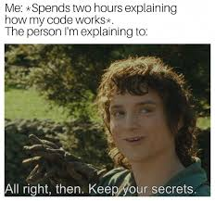
Scripts
Create a script to Backup using tar (From a file with a directory list)
Adrianna's video on how to use tar https://www.youtube.com/watch?v=x0EK6PmKRCU
Create a script to collect a Disk usage report

Slide 9
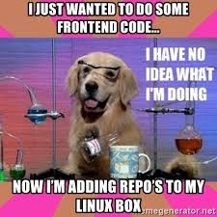
What is a repository?
A way to collect and organize software
Also known as a way to collect packages
Personal Package Archive (PPA)
Source of software compatible with your system

Slide 10
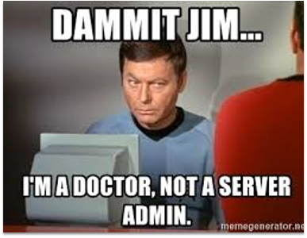
Why do we have them?
Easy way to organize software
Can split software by version, or kernel, etc.
Helps keep you using compatible software
Can also host OS updates

Slide 11
What are some common repositories?
Standard and non-standard repositories
Standard comes with the machine (should work without issue)
Non-standard must be added separately (Who knows?)
Ubuntu has some extras/different vocab
Universe (community maintained and open source)
Multiverse (Restricted by copyright/legal)
Main repository – supported programs
Restricted – propriety, may include device drivers

Slide 12
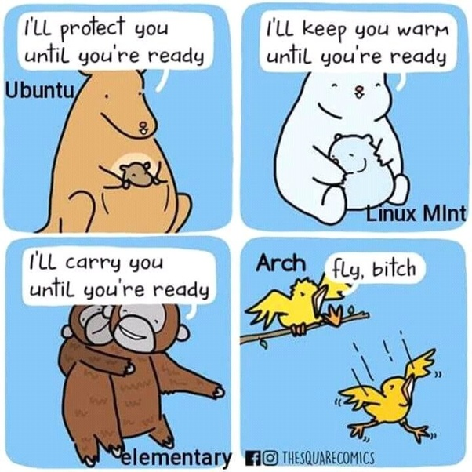
Activity
What repositories are already on your system?
Where did you find the list of repos?
What might be another useful repo to add (if any)?

Slide 13
How do you add a repository?
You will need to use sudo
For CentOS https://wiki.centos.org/AdditionalResources/Repositories
In OpenSuse - zypper addrepo In Mandriva - urpmi.addmedia In Debian or Ubuntu - open and edit "/etc/apt/sources.list" In Fedora -"/etc/yum.repos.d/"
Debian based systems can be done on commandline or by changes the sources.list
https://www.networkworld.com/article/3305810/how-to-list-repositories-on-linux.html

Slide 14
Repository safety and you
Adding unknown repositories represent a safety risk because they can install things on your system and update/change your OS
Equivalent of saying yes please give randomprogram full admin rights
Do you trust the person hosting the repo/PPA?
How many people have (safely) used this repo/PPA before you?
How up to date is this repo/PPA?
Can you troubleshoot when something goes wrong?
Is this repo/PPA still in testing, or production ready?

Slide 15
Patches vs Update vs Upgrade
Testing! Oh so much testing
A patch fixes a critical error generally in a specific spot
Update gets the latest version but doesn't install (do this first)
Upgrade installs newest version
Install package-name installs or updates to latest version
All can cause issues
Server Admins usually test updates and patches before sending them company wide
Windows Patch Tuesday disasters
Can break your system and be incompatible with programs you have installed
Not unheard of for patches/updates to cripple a system

